Slide 1
Q-Learning (Yet Again!)
Scott O’Hara
Metrowest Developers Machine Learning Group
12/12/2018

Slide 2
References
University of California, Berkeley CS188:
CS188 – Introduction to Artificial Intelligence, Profs. Dan Klein, Pieter Abbeel, et al. http://ai.berkeley.edu/home.html
David Silver, DeepMind:
Introduction to Reinforcement Learning http://www0.cs.ucl.ac.uk/staff/d.silver/web/Teaching.html
CS181 course at Harvard University:
CS181 Intelligent Machines: Perception, Learning and Uncertainty, Sarah Finney, Spring 2009
CS181 Intelligent Machines: Perception, Learning and Uncertainty, Prof. David C Brooks, Spring 2011
CS181 – Machine Learning, Prof. Ryan P. Adams, Spring 2014. https://github.com/wihl/cs181-spring2014
CS181 – Machine Learning, Prof. David Parkes, Spring 2017. https://harvard-ml-courses.github.io/cs181-web-2017/
The material for this talk is primarily drawn from the slides, notes and lectures of these courses:

Slide 3
Q-Learning: Talk outline
Reinforcement Learning
What is Q-Learning
Q-Learning Demos
Approximate Q-Learning

Slide 4
Reinforcement Learning

Slide 5
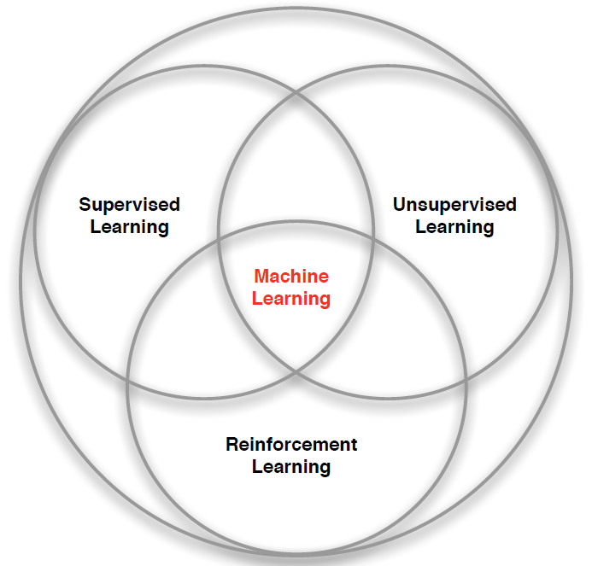
branches of Machine Learning
Credit: adapted from lecture slides David Silver, DeepMind, “Introduction to Reinforcement Learning

Slide 6
Reinforcement Learning: the basic idea
Select an action.
If action leads to reward, reinforce that action.
If action leads to punishment, avoid that action.
Basically, a computational form of Behaviorism (Pavlov, B. F. Skinner).

Slide 7
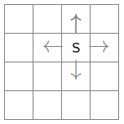
the Learning framework
Learning is performed online, learn as we interact with the world
In contrast with supervised learning, there are no training or test sets. The reward is accumulated over interactions with the environment.
Data is not fixed, more information is acquired as you go.
The training distribution can be influenced by action decisions.

Slide 8
Examples of Reinforcement Learning
Fly stunt maneuvers in a helicopter
Defeat the world champion at Backgammon
Manage an investment portfolio
Control a power station
Make a humanoid robot walk
Play Atari games better than humans
Credit: adapted from lecture slides David Silver, DeepMind, “Introduction to Reinforcement Learning

Slide 9
Examples of Reinforcement Learning
RL Course by David Silver – Lecture1: Introduction to Reinforcement Learning
https://www.youtube.com/watch?v=2pWv7GOvuf0
12:25 – 22.00
Credit: adapted from lecture slides David Silver, DeepMind, “Introduction to Reinforcement Learning

Slide 10
Q-Learning

Slide 11
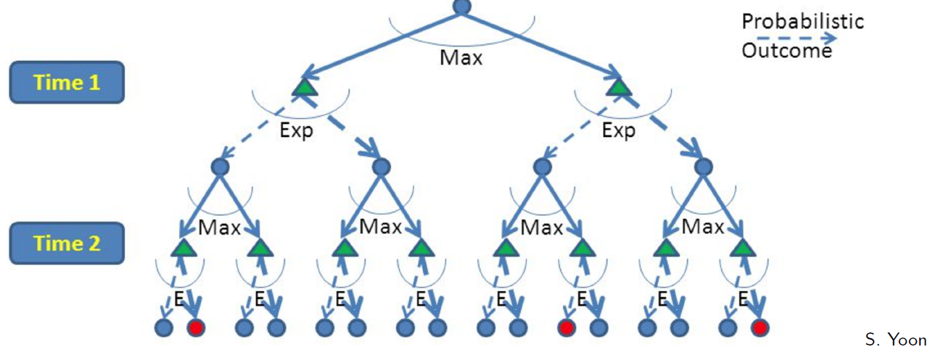
RL is like A game against Nature
Reinforcement learning is like a game-playing algorithm.
Nodes where you move are called states: S ( )
Nodes where nature “moves” are called Q-states: <S,A> ( )
Credit: CS188 – Intro to AI, UC Berkeley, ai.berkely.edu

Slide 12
Quantities to optimize
The value (utility) of a state s:
V(s) = expected utility starting in s and acting optimally
The value (utility) of a q-state (s,a):
Q(s,a) = expected utility starting out having taken action a from state s and (thereafter) acting optimally
The optimal policy:
π(s) = optimal action from state s
s
s is a state
a
(s, a) is a q-state
s, a
s,a,s’
(s,a,s’) is a transition
s’
Credit: CS188 – Intro to AI, UC Berkeley, ai.berkely.edu
Notes:
Demo just shows V and Q values, snapshots on next slides.

Slide 13
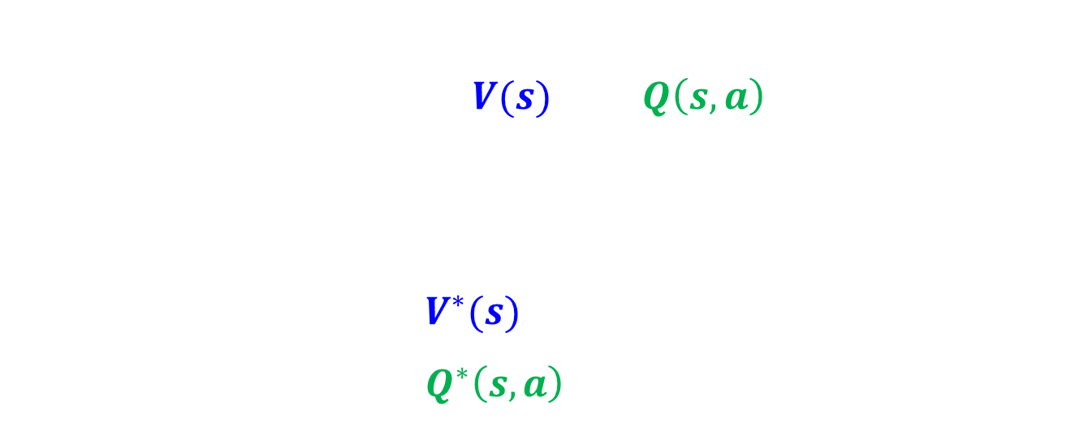
The Bellman Equations
s
The Bellman Equations define a relationship, which when satisfied guarantees that $V(s)$ and $Q\left(s,a\right)$ are optimal for each state and action.
This in turn guarantees that the policy $π^{∗}$is optimal.
There is one equation $V^{∗}(s)$ for each state s.
There is one equation $Q^{∗}\left(s,a\right)$ for each state s and action a.
a
s, a
s,a,s’
s’
Credit: CS188 – Intro to AI, UC Berkeley, ai.berkely.edu
Credit: CS181 – Machine Learning, D. Parkes, Harvard Univ, Spring 2017
Notes:
Let’s start by equations that characterize these quantities through mutual recursions. [step through this by writing on slide, one step at a time]
Recursive characterization of V* in terms of V*; not necessarily helpful; but it is a characterization.
Note: this is a set of equations that needs to be satisfied; but it could have multiple solutions (it does not, but at this stage of our knowledge it could).

Slide 14



The Bellman Equations
States: $s_{1},…,s_{n}$
Actions: $a_{1},…,a_{m}$
Reward Function:
$R\left(s,a,s′\right)∈R$
Transition model:
T(s,a,s’)= $P\left(s′ | s, a\right)$
Discount factor: $γ∈\left[0,1\right]$
s
a
s, a
s,a,s’
s’
<https://en.wikipedia.org/w/index.php?title=Markov_decision_process&oldid=855934986> [accessed 11 September 2018]

Slide 15
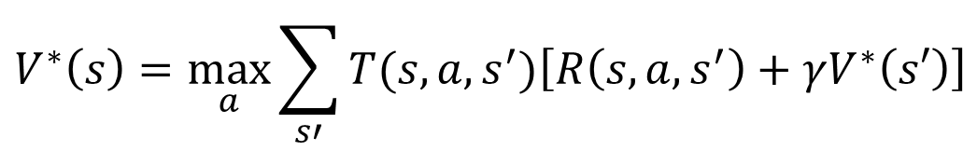
The optimal Value utility Equation V*
Focusing on different Bellman Equations Gives Different Algorithms
The V* equation gives rise to these algorithms previously discussed:
Expectimax
Value Iteration
Policy Iteration
[1]
[2]
$$V^{∗}\left(s\right)=\max_{a}\sum_{s′}{T(s,a,s^{′})\left[R\left(s,a,s^{′}\right)+γV^{∗}\left(s′\right)\right]}$$
Credit: CS188 – Intro to AI, UC Berkeley, ai.berkely.edu
Credit: CS181 – Machine Learning, D. Parkes, Harvard Univ, Spring 2017
Notes:
Let’s start by equations that characterize these quantities through mutual recursions. [step through this by writing on slide, one step at a time]
Recursive characterization of V* in terms of V*; not necessarily helpful; but it is a characterization.
Note: this is a set of equations that needs to be satisfied; but it could have multiple solutions (it does not, but at this stage of our knowledge it could).

Slide 16
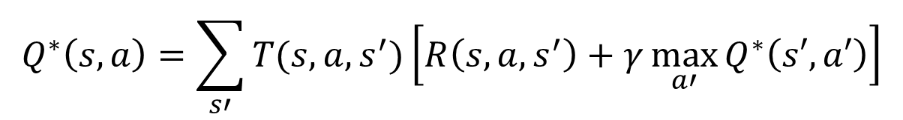
The optimal Value utility Equation Q*
[1]
The Q* equation gives rise to the Q-Learning algorithm.
[2]
$$Q^{∗}\left(s,a\right)=\sum_{s′}{T(s,a,s^{′})\left[R\left(s,a,s^{′}\right)+γ\max_{a′}{Q^{∗}\left(s′,a′\right)}\right]}$$
Credit: CS188 – Intro to AI, UC Berkeley, ai.berkely.edu
Credit: CS181 – Machine Learning, D. Parkes, Harvard Univ, Spring 2017
Notes:
Let’s start by equations that characterize these quantities through mutual recursions. [step through this by writing on slide, one step at a time]
Recursive characterization of V* in terms of V*; not necessarily helpful; but it is a characterization.
Note: this is a set of equations that needs to be satisfied; but it could have multiple solutions (it does not, but at this stage of our knowledge it could).

Slide 17

Model-Based vs. Model-Free
Model-Based RL
Explicitly learn:
the transition model T(s,a,s’)
The reward model R(s,a,s’)
Use Value Iteration, etc. to find optimal policy $π^{∗}.$
Model-Free RL
Don’t learn T(s,a,s’) and R(s,a,s’).
Q-Learning – learn Q(s,a) directly.

Slide 18
Model-Based RL pros and Cons
Pros:
Makes maximal use of experience.
Solves model optimally, given enough experience.
Cons:
Requires computationally expensive solution procedure.
Requires the model to be small enough to solve

Slide 19
Model-Free RL pros and Cons
Pros:
Solution procedure is much more efficient.
Can handle much larger models.
Cons:
Learns more slowly.
Does not learn as much as a model-based RL in a single training episode. (“Leaves information on the table”).

Slide 20
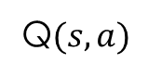
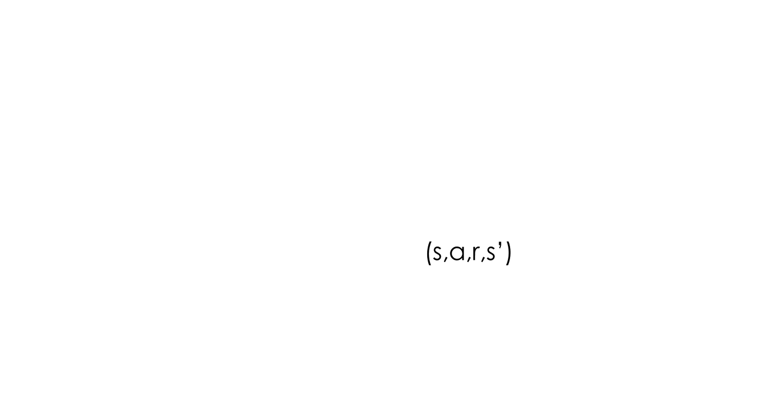
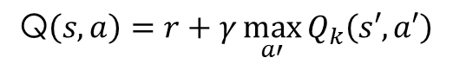
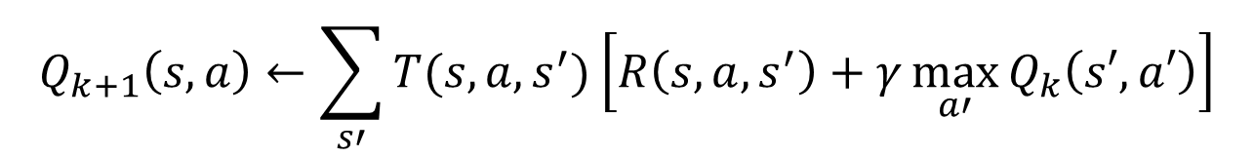
Q-Learning
What to do about T(s,a,s’) and R(s,a,s’), since we don’t have these functions?
Use sampling to learn Q(s,a) values as you go
Receive a sample transition: (s,a,r,s’)
Consider your old estimate:
Consider your new sample estimate:
Incorporate the new estimate into a running average based on the learning rate $α$:
$$Q_{k+1}\left(s,a\right)←\sum_{s′}{T(s,a,s^{′})\left[R\left(s,a,s^{′}\right)+γ\max_{a′}{Q_{k}\left(s′,a′\right)}\right]}$$
Q$(s,a)$
$$\text{Q}\left(s,a\right)=r+γ\max_{a′}{Q_{k}\left(s′,a′\right)}$$
$$Q\left(s,a\right)←\left(1−α\right)Q\left(s,a\right)+α\left[r+γ\max_{a′}{Q_{k}\left(s′,a′\right)}\right]$$

Slide 21

Q-Learning update rule
On transitioning from state s to state s’ on action a, and receiving reward r, update:
$α$ is the learning rate
A large $α$ results in quicker learning but may not converge.
$α$ is often decreased as learning goes on.
$γ$ is the discount rate i.e., discounts future rewards
$$Q\left(s,a\right)←\left(1−α\right)Q\left(s,a\right)+α\left[r+γ\max_{a′}{Q_{k}\left(s′,a′\right)}\right]$$

Slide 22
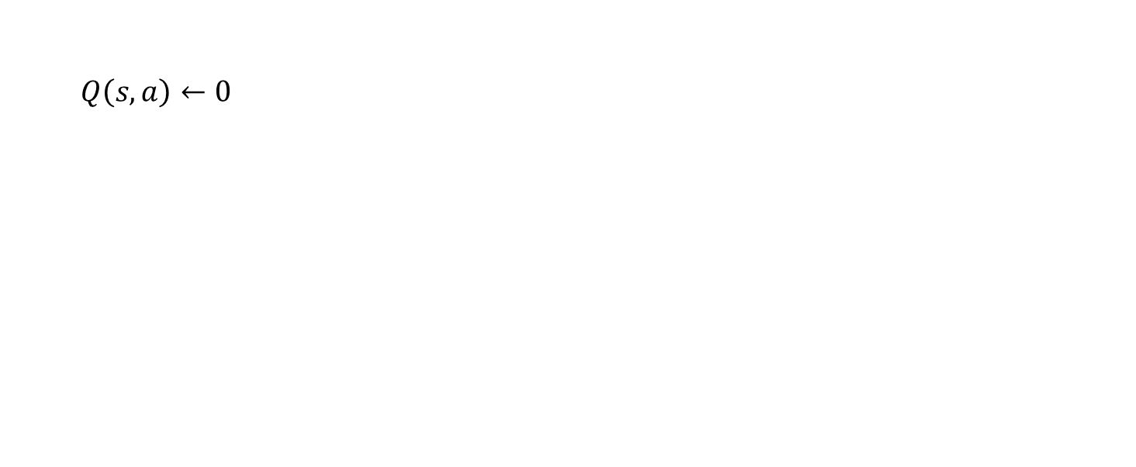
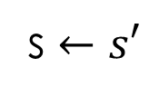
Q-Learning algorithm
For each state s and action a:
$Q\left(s,a\right)←0$
Begin in state s:
Repeat:
Given s and the set of actions $A_{s}$associated with s:
CHOOSE ACTION $a∈A_{s}$ ← HOW?
Apply action a.
Receive reward r and new state s’.
With transition <s,a,r,s’>, update Q(s,a)
$$Q\left(s,a\right)←\left(1−α\right)Q\left(s,a\right)+α\left[r+γ\max_{a′}{Q_{k}\left(s′,a′\right)}\right]$$
s $←s′$

Slide 23
choosing an action: exploration vs exploitation
Exploit: maximize the expected utility now.
Explore: choose an action that will help you improve your model.
How to Exploit? use the current policy.
e.g., for Q-Learning in state s, choose action with largest Q(s,a)
How to Explore?
choose an action randomly
choose an action you haven’t chosen yet
choose an action that will take you to an unexplored state.

Slide 24


exploration strategy: $ε$-greedy
Explore with probability $ε.$ Exploit with probability $1−ε.$
Weaknesses:
Does not exploit when learning has converged.
Uses:
appropriate if the world is changing.

Slide 25

exploration strategy: Boltzmann
In state s, choose action a with probability p:
$$p=\frac{e^{\frac{Q(s,a)}{t}}}{\sum_{a′}{e^{\frac{Q(s,a^{′})}{t}}}}$$
Simulated annealing: t is a “temperature” which “cools” over time.
High temperature means more exploration
$e^{\frac{Q(s,a)}{t}}→1$, implies actions taken at about equal probability.
As t cools, exploration is reduced.
$e^{\frac{Q(s,a)}{t}}→∞$, largest $Q\left(s,a\right)$ becomes most probable.

Slide 26
Q-learning Demos

Slide 27
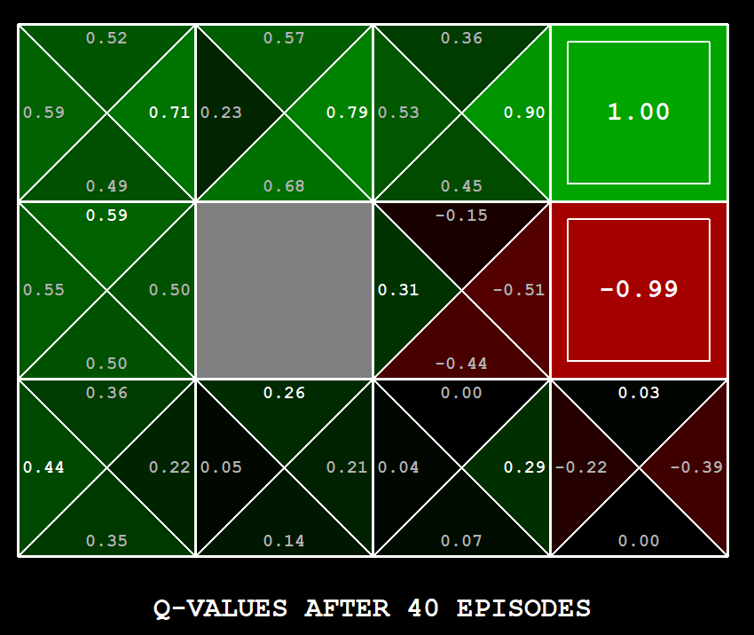
Q-Learning Example: gridworld
Notes:
python gridworld.py -k 40 -w 200 -s 2.0 -a q –v [-p]

Slide 28
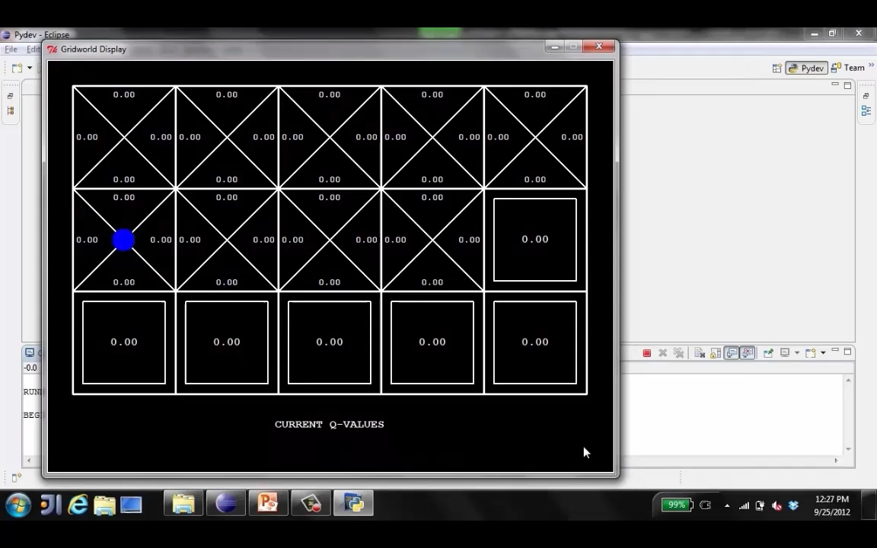
Video of Q-Learning demo -- Gridworld

Slide 29
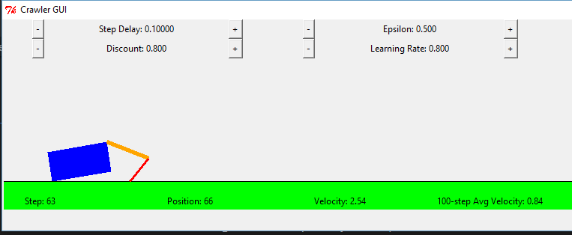
Q-Learning Example: Crawler Robot
Credit: CS188 – Intro to AI, UC Berkeley, ai.berkely.edu

Slide 30
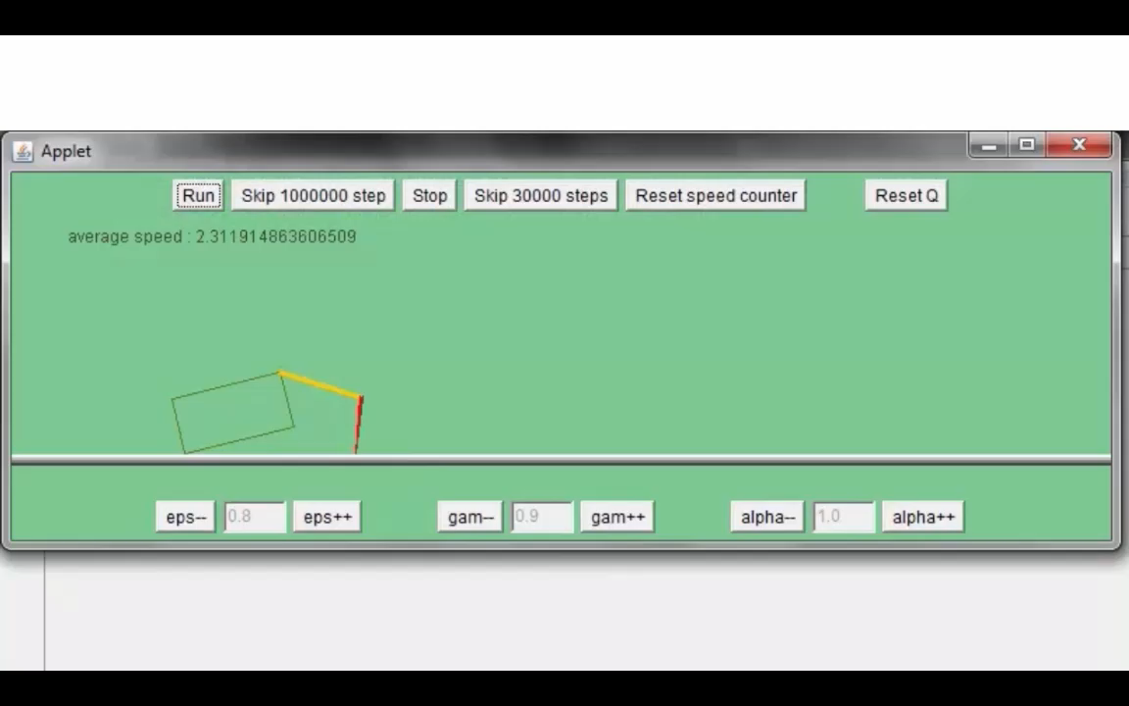
Video 1 of Q-Learning demo -- Crawler
Credit: CS188 – Intro to AI, UC Berkeley, ai.berkely.edu

Slide 31
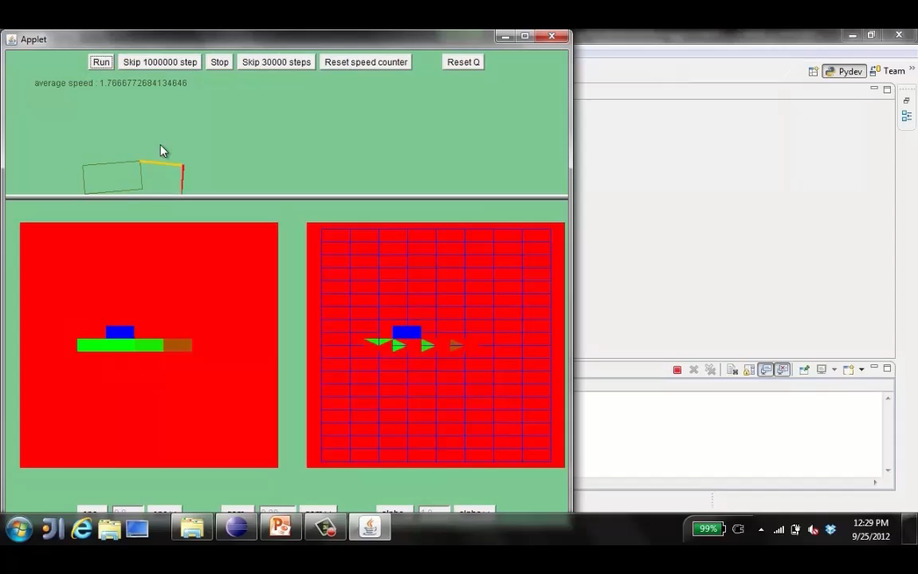
Video 2 of Q-Learning demo -- Crawler
Credit: CS188 – Intro to AI, UC Berkeley, ai.berkely.edu

Slide 32
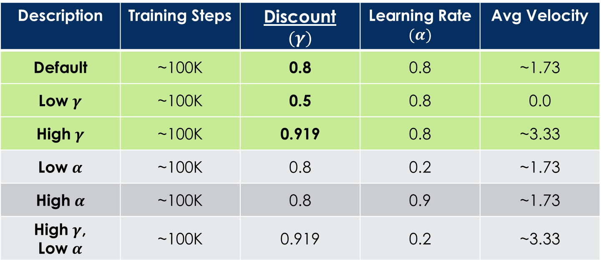
Q-Learning Example: discount effect
Update rule:
Description | Training Steps | Discount $$(γ)$$ | Learning Rate $$(α)$$ | Avg Velocity
Default | ~100K | 0.8 | 0.8 | ~1.73
Low $γ$ | ~100K | 0.5 | 0.8 | 0.0
High $γ$ | ~100K | 0.919 | 0.8 | ~3.33
Low $α$ | ~100K | 0.8 | 0.2 | ~1.73
High $α$ | ~100K | 0.8 | 0.9 | ~1.73
High $γ$, Low $α$ | ~100K | 0.919 | 0.2 | ~3.33

Slide 33

Q-Learning Properties
Amazing result: Q-learning converges to optimal policy -- even if you’re acting sub-optimally!
This is called off-policy learning
Caveats:
You have to explore enough
You have to eventually make the learning rate
small enough
… but not decrease it too quickly
Basically, in the limit, it doesn’t matter how you select actions (!)
Credit: CS188 – Intro to AI, UC Berkeley, ai.berkely.edu

Slide 34

Approximate Q-Learning
Credit: CS188 – Intro to AI, UC Berkeley, ai.berkely.edu

Slide 35


Generalizing Across States
Basic Q-Learning keeps a table of all q-values
In realistic situations, we cannot possibly learn about every single state!
Too many states to visit them all in training
Too many states to hold the q-tables in memory
Instead, we want to generalize:
Learn about some small number of training states from experience
Generalize that experience to new, similar situations

Slide 36
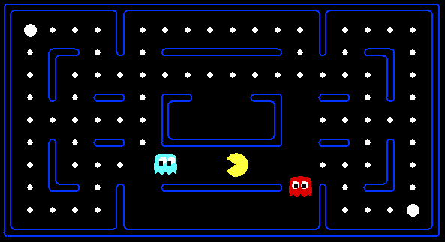



Example: Pacman
Let’s say we discover through experience that this state is bad:
In naïve q-learning, we know nothing about this state:
Or even this one!
Credit: CS188 – Intro to AI, UC Berkeley, ai.berkely.edu

Slide 37
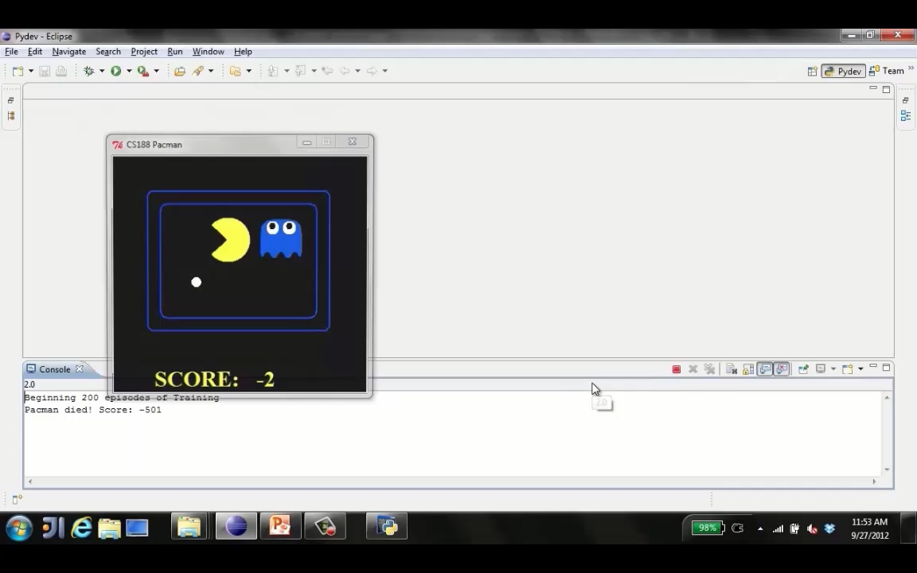
Tiny pacman demo 1
Credit: CS188 – Intro to AI, UC Berkeley, ai.berkely.edu

Slide 38
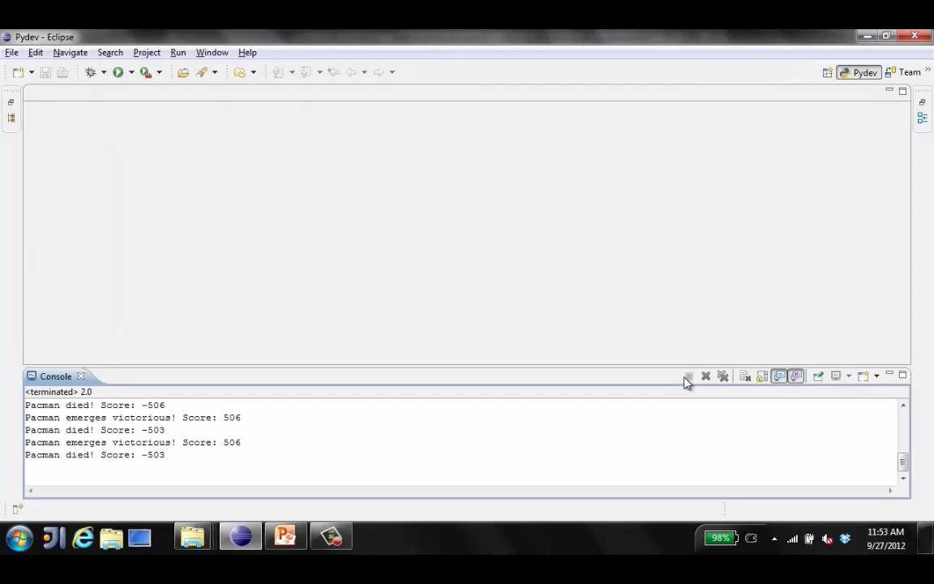
Tiny pacman demo 2
Credit: CS188 – Intro to AI, UC Berkeley, ai.berkely.edu

Slide 39
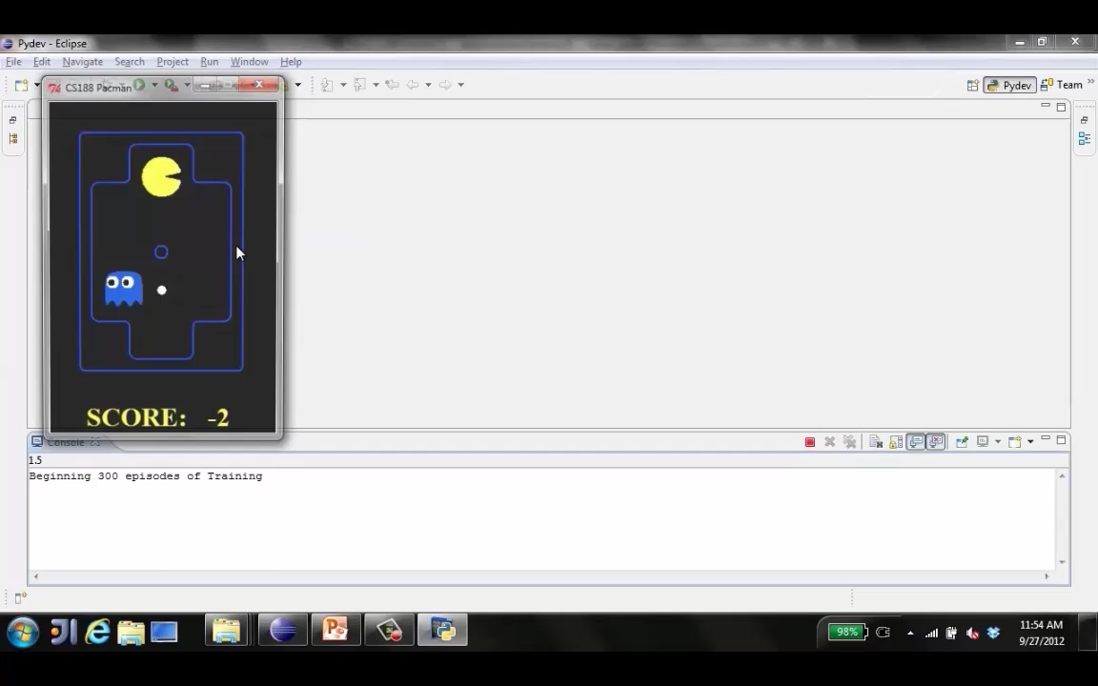
Tiny pacman demo 3
Credit: CS188 – Intro to AI, UC Berkeley, ai.berkely.edu

Slide 40


Feature-Based Representations
Solution: describe a state using a vector of features (properties)
Features are functions from states to real numbers (often 0/1) that capture important properties of the state
Example features:
Distance to closest ghost
Distance to closest dot
Number of ghosts
1 / (dist to dot)²
Is Pacman in a tunnel? (0/1)
…… etc.
Is it the exact state on this slide?
Can also describe a q-state (s, a) with features (e.g. action moves closer to food)
Credit: CS188 – Intro to AI, UC Berkeley, ai.berkely.edu

Slide 41
Linear Value Functions
Using a feature representation, we can write a q function (or value function) for any state using a few weights:
Advantage: our experience is summed up in a few powerful numbers
Disadvantage: states may share features but actually be very different in value!
Credit: CS188 – Intro to AI, UC Berkeley, ai.berkely.edu

Slide 42


Approximate Q-Learning
Q-learning with linear Q-functions:
transition = (s,a,r,s’)
difference = $\left[r+γ\max_{a′}{Q(s^{′},a^{′})}\right]−Q(s,a)$
$Q\left(s,a\right)←Q\left(s,a\right)+α\left[\text{difference}\right]$ ← Exact Q’s
$w_{i}←w_{i}+α\left[\text{difference}\right]f_{i}{(s,a)}$ ← Approximate Q’s
Intuitive interpretation:
Adjust weights of active features.
E.g., if something unexpectedly bad happens, blame the features that were on i.e., prefer less all states with that state’s features.
Formal justification: online least squares
Credit: CS188 – Intro to AI, UC Berkeley, ai.berkely.edu

Slide 43
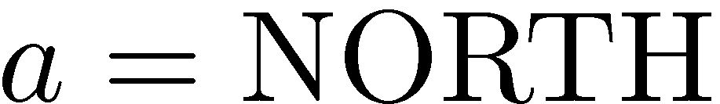











Example: Q-Pacman
$$Q\left(s,a\right)=4.0f_{DOT}\left(s,a\right)−1.0f_{GST}\left(s,a\right)$$
$$f_{DOT}\left(s,NORTH\right)=0.5$$
$$s$$
$$s′$$
$$f_{GST}\left(s,NORTH\right)=1.0$$
$$Q\left(s,NORTH\right)=+1$$
$$Q\left(s^{′},∙\right)=0$$
$$r+γ\max_{a′}{Q\left(s^{′},a^{′}\right)=−500+0}$$
$$w_{DOT}{←4.0+α\left[−501\right]0.5}$$
$$\text{difference}=−501$$
$$w_{GST}{←−1.0+α\left[−501\right]1.0}$$
$$Q\left(s,a\right)=3.0f_{DOT}\left(s,a\right)−3.0f_{GST}\left(s,a\right)$$
Credit: CS188 – Intro to AI, UC Berkeley, ai.berkely.edu

Slide 44
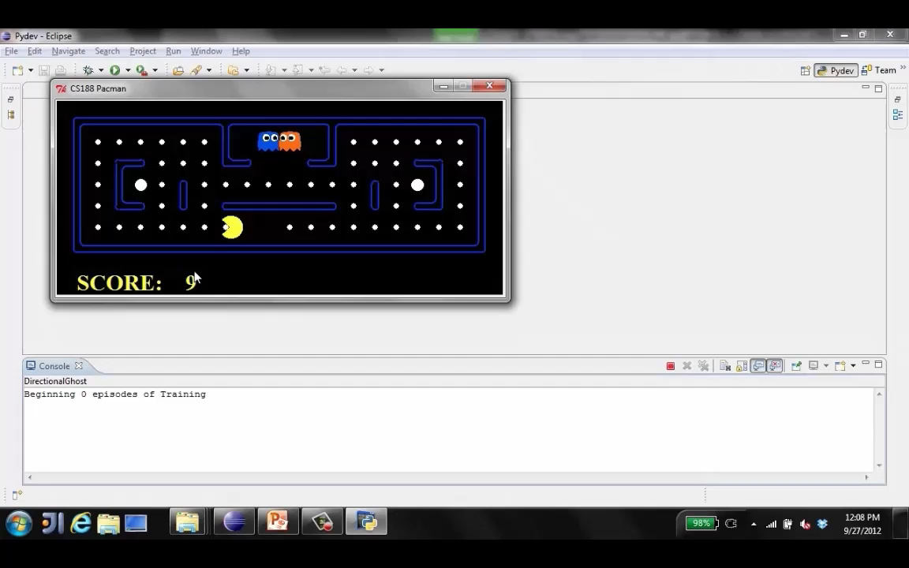
Approximate Q-Learning demo -- pacman
Credit: CS188 – Intro to AI, UC Berkeley, ai.berkely.edu

Slide 45
Next Time: More RL
Possible Topics:
Credit Assignment
Online Learning vs Offline learning
SARSA vs Q-Learning
Hybrid Approaches:
Temporal Difference (TD) Value Learning
Dyna-Q
Partially Observable Markov Decision Processes (POMDPs)
Deep Q-Learning

Slide 46
Extra slides

Slide 47
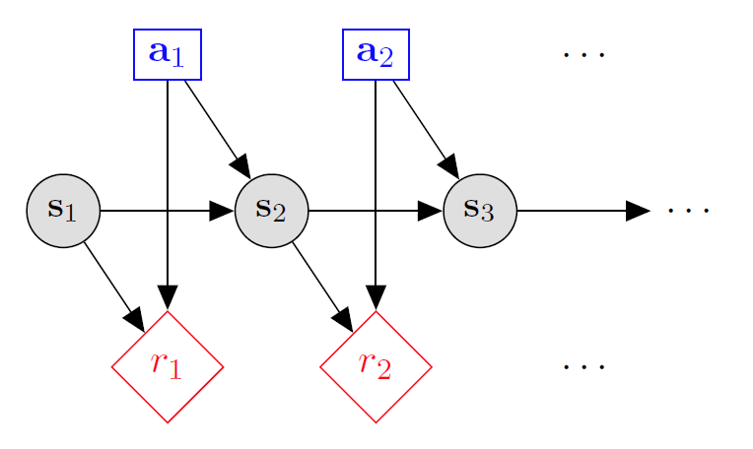

Markov decision processes
States: $s_{1},…,s_{n}$
Actions: $a_{1},…,a_{m}$
Reward Function:
$r\left(s,a,s′\right)∈R$
Transition model:
T(s,a,s’)= $P\left(s′ | s, a\right)$
Discount factor: $γ∈\left[0,1\right]$
<https://en.wikipedia.org/w/index.php?title=Markov_decision_process&oldid=855934986> [accessed 11 September 2018]

